Slide 1
Deployment SmarterASP.NET

Slide 2
Sign Up

Slide 3
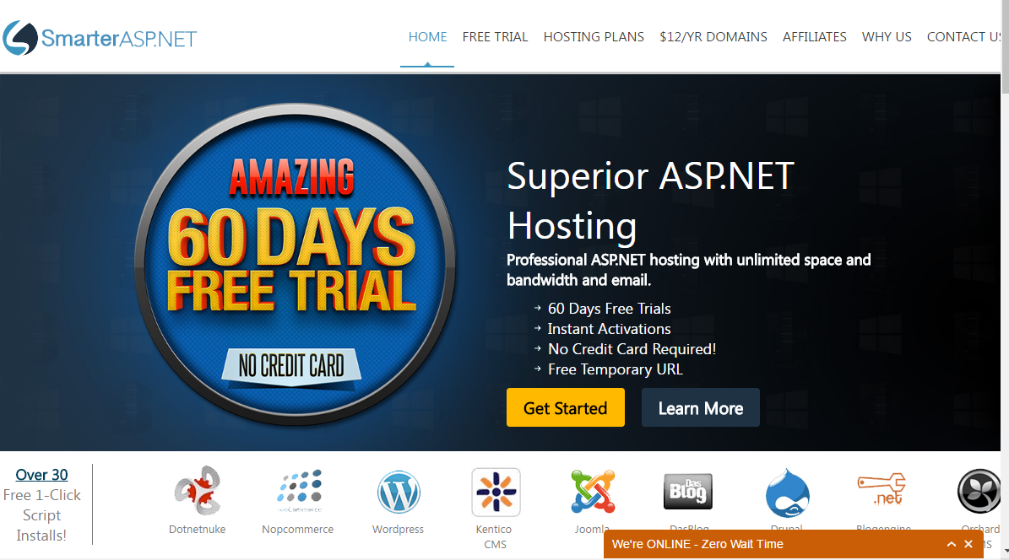
Recommended web hosting service
www.smarterasp.net
There is sometimes a 30 day free trial (60 days if you like them on Facebook and Google+)
If you want to publish an ASP.NET project, you will need to buy a domain (about US$16)
If you decide to sign up, you will probably need the .NET Advance plan ($5 per month)
At the moment, we haven’t tested SmarterASP.NET’s email functionality, but we will do this very soon. (There is a workaround if their email isn’t up to scratch.)

Slide 4
Recommended web hosting service
There can be security issues with signing up to SmarterASP.NET from the training room
If you sign up from the training room, you MUST use PayPal to pay
If you use a credit card, it’s likely that your account will be cancelled, as multiple credit card sign-ups from the same IP address trigger their fraud alerts
If you want to use a credit card to pay, please sign up from home
Please don’t leave this until week 8, just in case there are problems

Slide 5
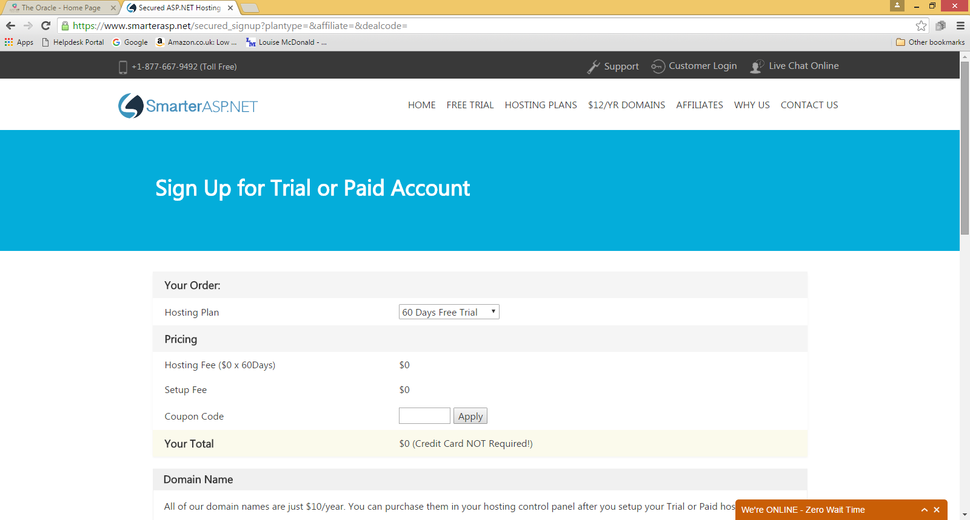
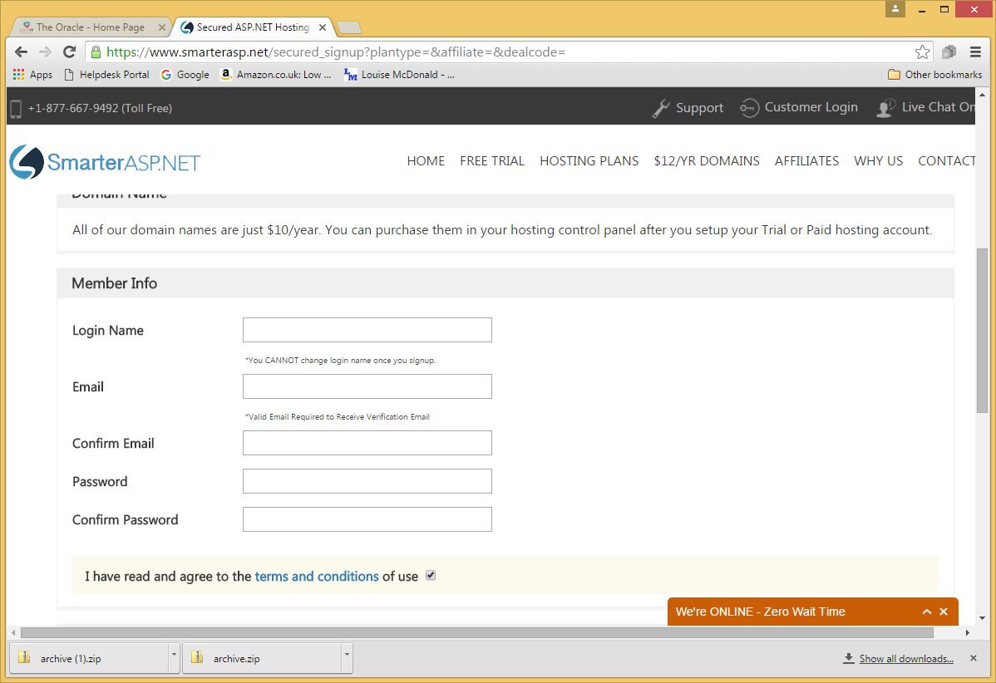
Sign up process

Slide 6
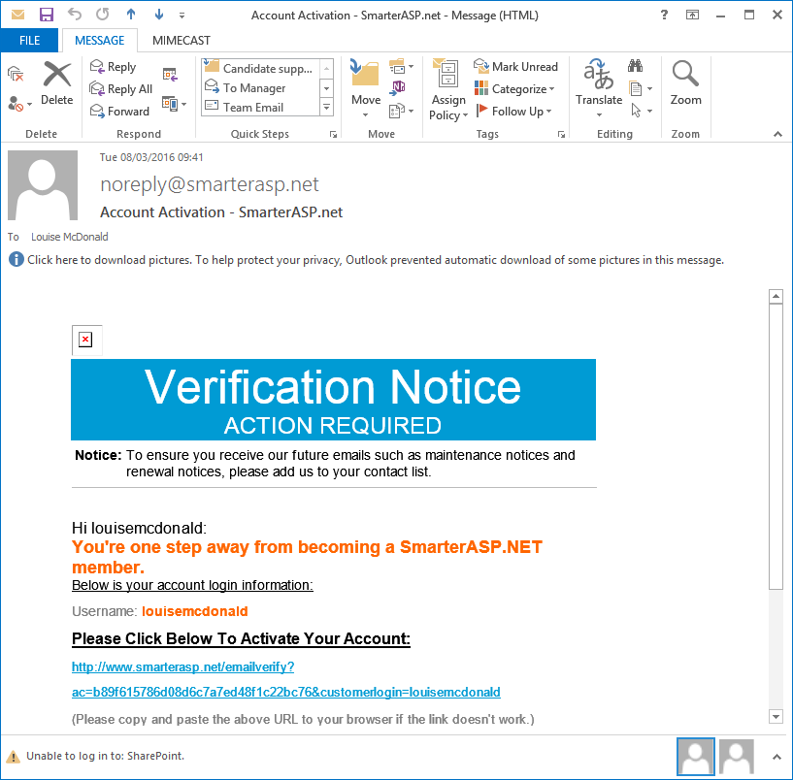
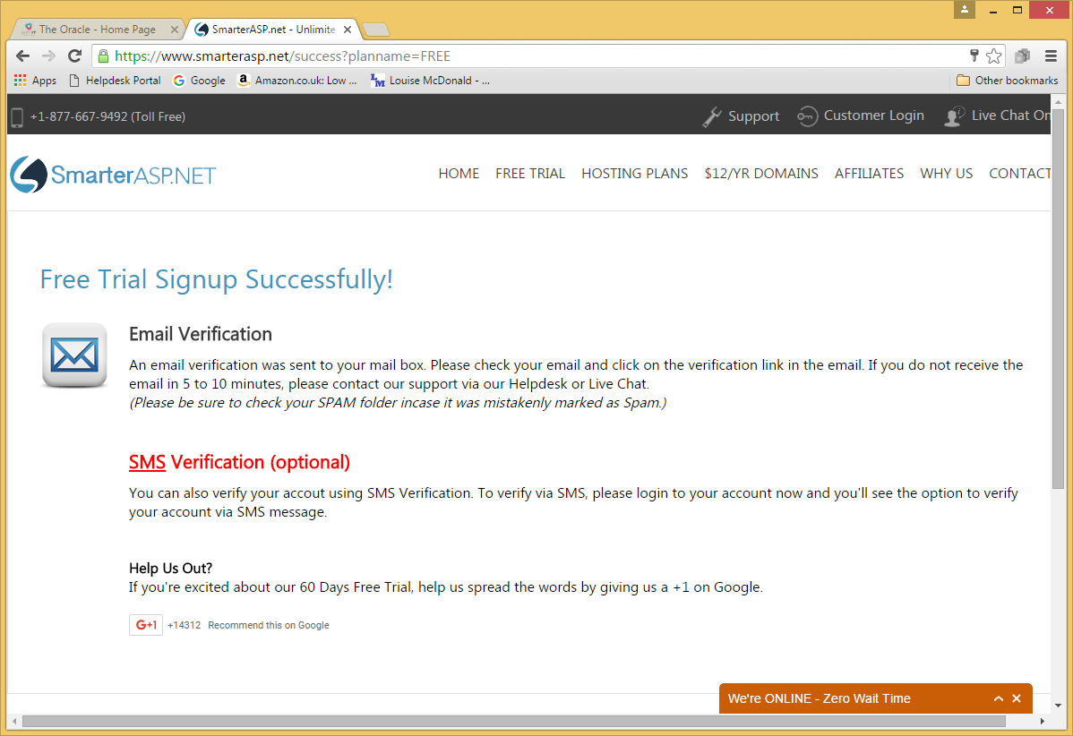
Sign-up process (cont.)
Go for SMS verification – you’ll have to do it later anyway

Slide 7
Hosting Account

Slide 8
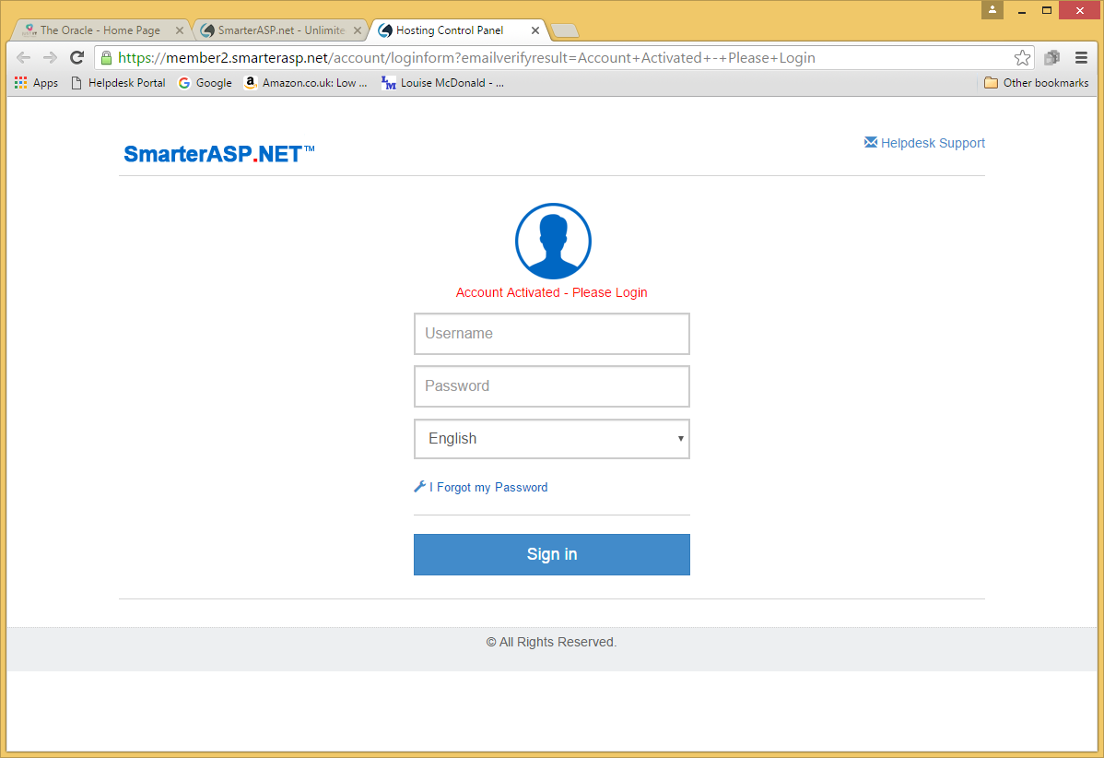
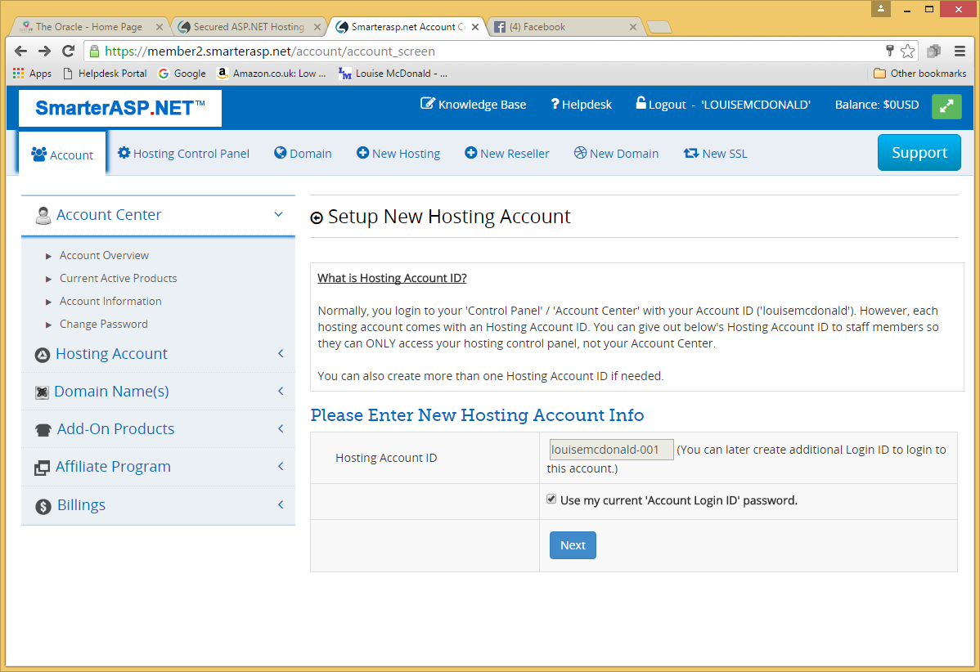
Setting up your hosting account
Their website has changed a bit, so this screen probably looks different, but it should still work the in the same way.

Slide 9
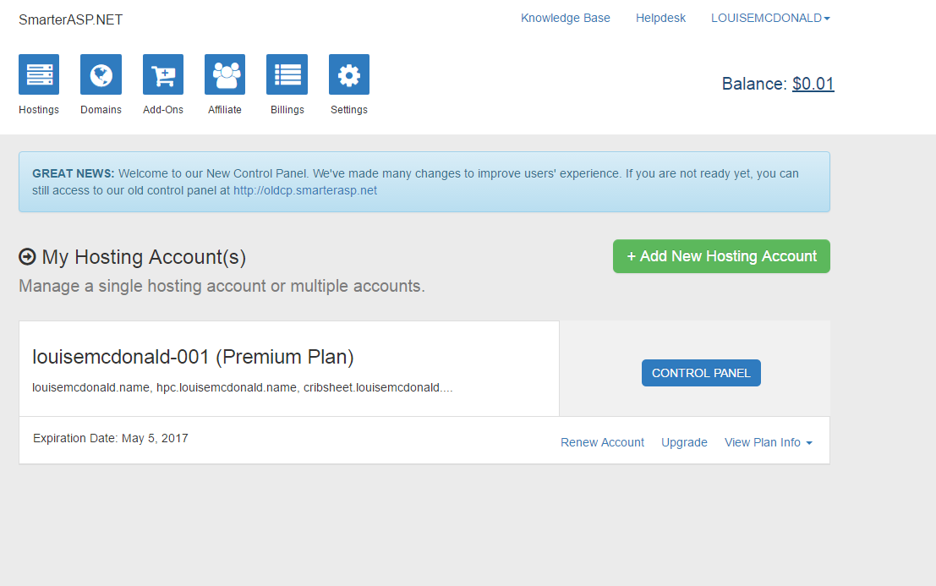
Account overview
Click on the Account Center tab to see this
Note that there will be no domain yet, and you will need one to publish an ASP.NET project

Slide 10
Hosting account information

Slide 11
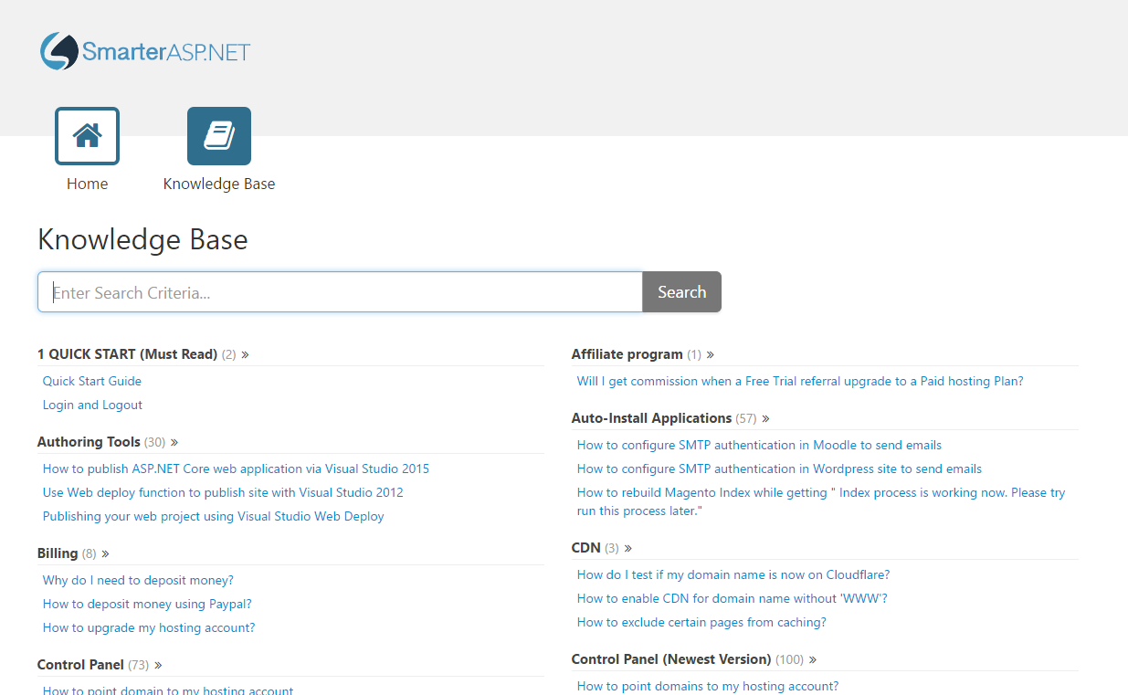
Knowledge Base
These are articles on various aspects of deployment with SmarterASP.NET. It’s worth checking this before contacting the helpdesk

Slide 12
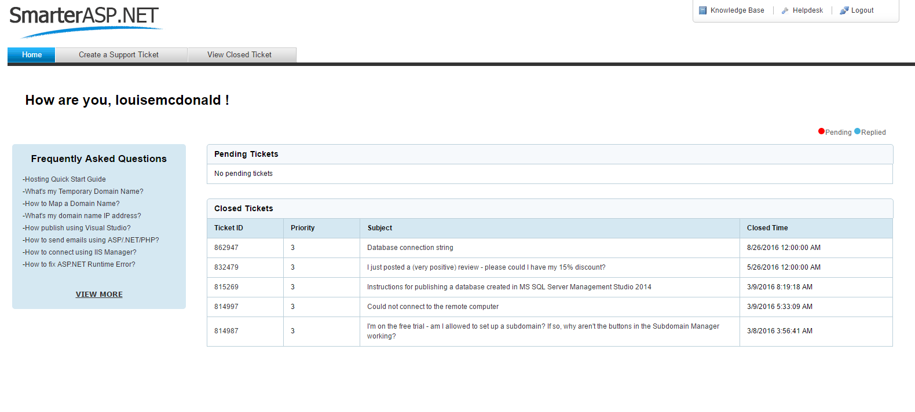
Helpdesk
Check the Knowledge Base first
If you still need help, raise a ticket
Response is usually within 5-10 mins
Staff are polite and usually accurate with their help

Slide 13
Deploying a portfolio
You will only do this on Smarter ASP.NET if you haven’t deployed your portfolio elsewhere (and please be aware that we haven’t yet included instructions for getting a contact form working).
Also, you will eventually buy a domain, and there are instructions on how to do this in the next section. But you don’t need to buy a domain before deploying your portfolio.

Slide 14
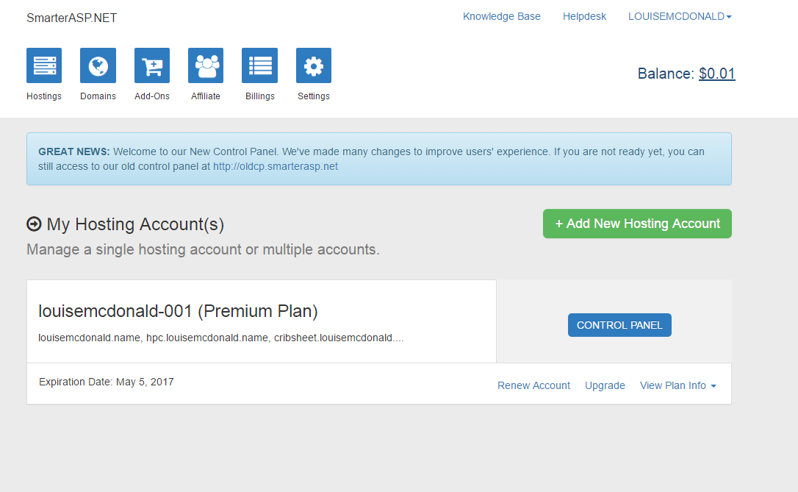
File upload for text files – HTML, CSS, etc.
If you want to put your portfolio on SmarterASP.NET, you will probably want to start by uploading the HTML, CSS, Javascript and other files for your portfolio website
If you prefer, you can also upload your portfolio with FTP, using a free utility like FileZilla
You would put your files under the Site1 folder
Click here to get to the screen with the Files tab

Slide 15
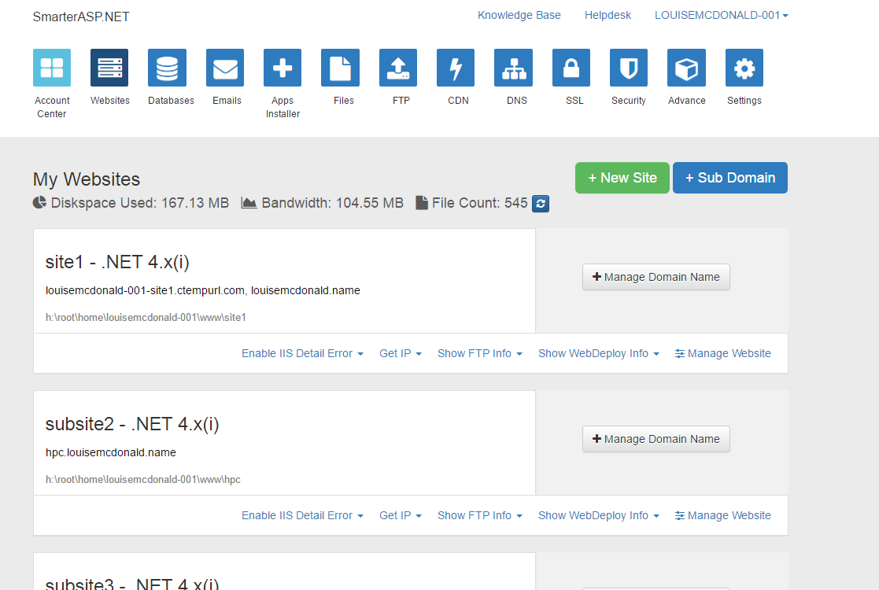
File upload for text files (2)
Click on the Files tab

Slide 16
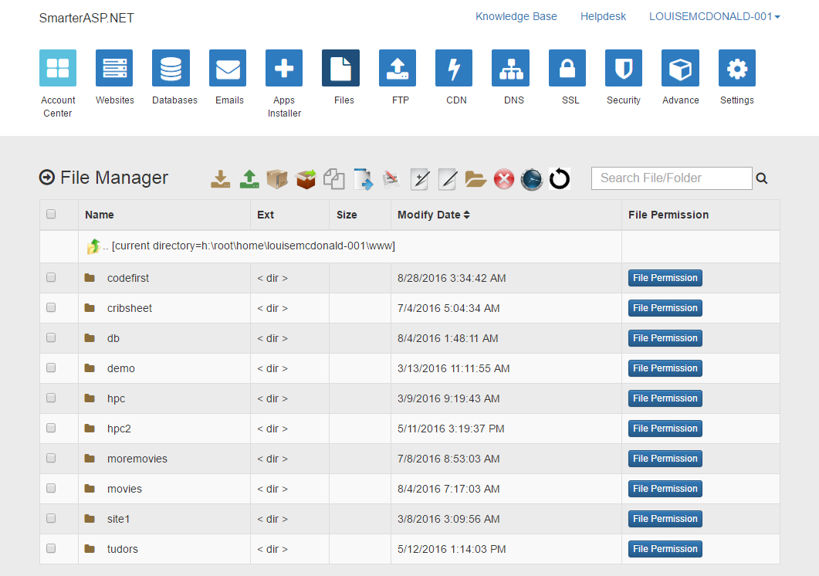
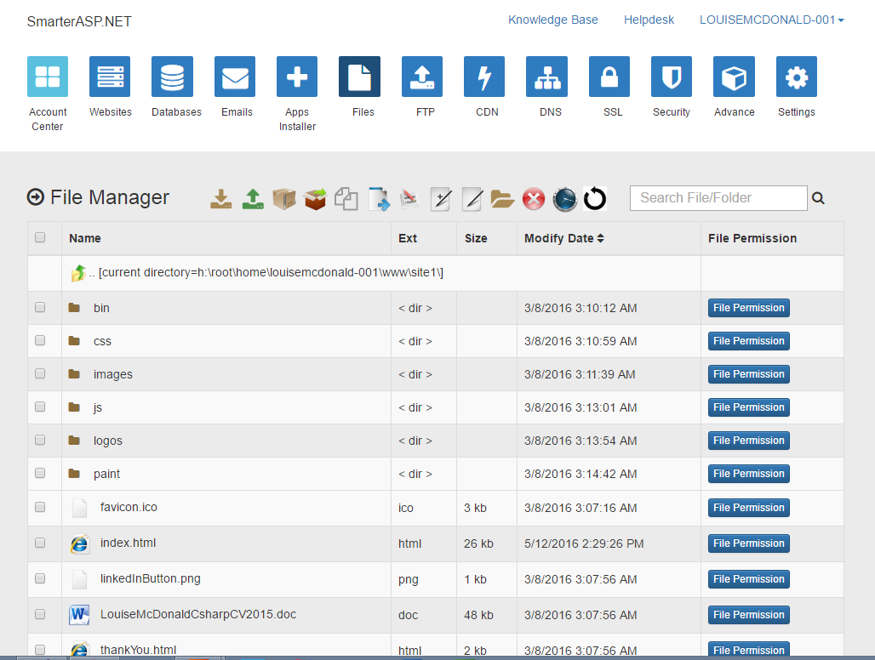
File upload for text files (4)
Use the New Folder and File Upload buttons to create your folder structure and upload your portfolio website files
Delete the default.asp file, as you don’t need it

Slide 17
File upload for text files (4)
You should end up with a screen looking like this for each folder
When you have completed your file uploads, your portfolio website will be ready to view

Slide 18
Deploying an ASP.NET project

Slide 19
Set up Domain

Slide 20
Deploying an ASP.NET project with or without a database
Here are the main things you need to know (covered in these slides):
You will need a domain, even if you are using SmarterASP.NET’s free trial
Domain names cost around US$16 (UK£12) for a year (these slides show this option)
Or you may be able to use one that you own already, but transferring a domain between hosting services can take up to a month
Once you have a domain, set up a sub-domain to publish to (free)
If your application uses a database
Create an area for a database on the SmarterASP.NET site
Then deploy your local database file to SmarterASP.NET
Publish your code using Visual Studio’s Publish option

Slide 21
Buying a domain (1)

Slide 22
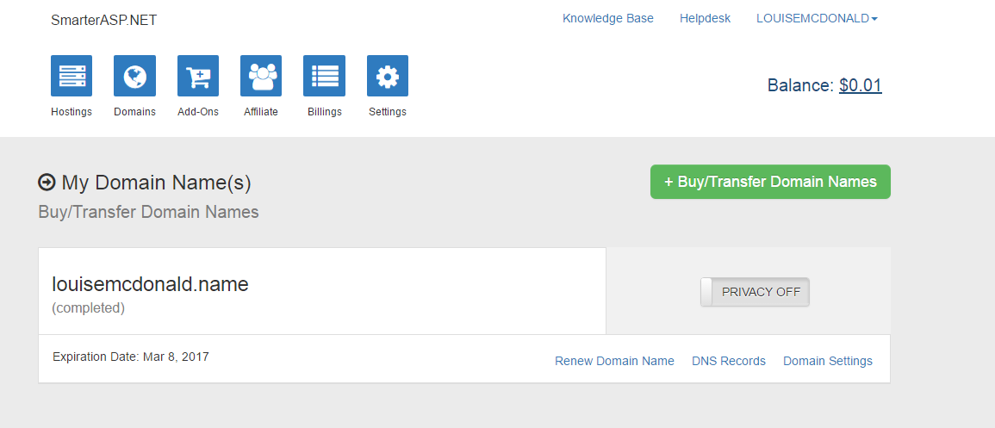
Buying a domain (2)

Slide 23
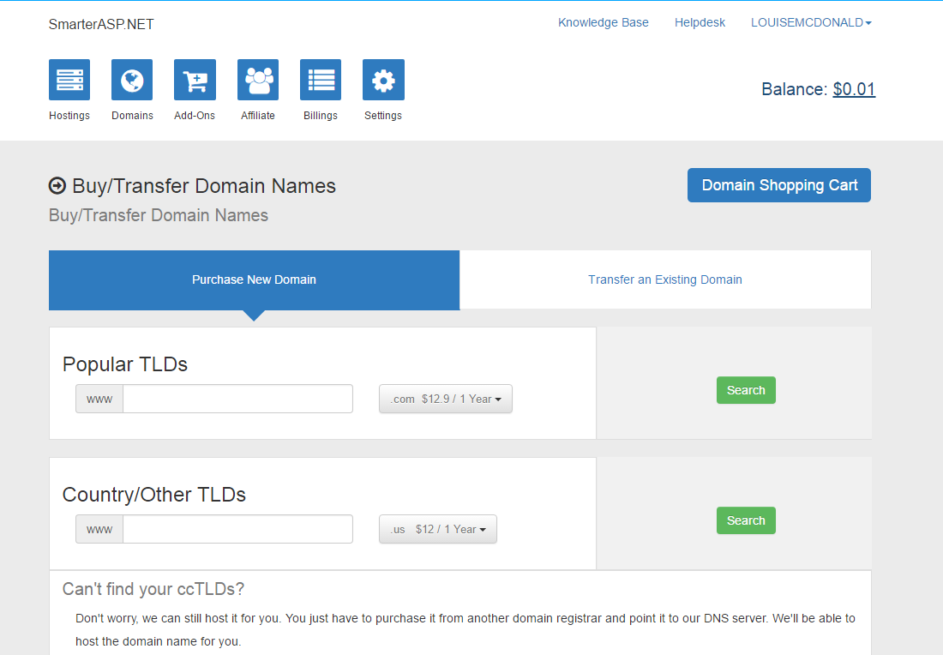
Buying a domain (3)
Click on either of these to see domain extensions and prices

Slide 24
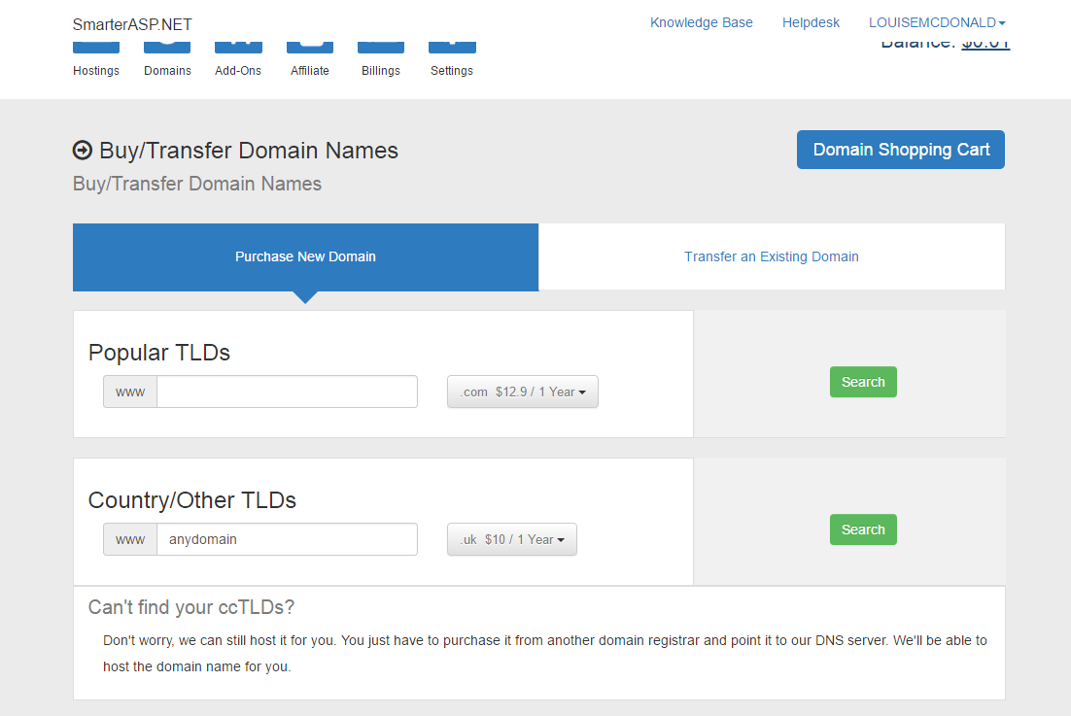
Buying a domain (4)
Type in a domain name
Choose an extension
Click search

Slide 25
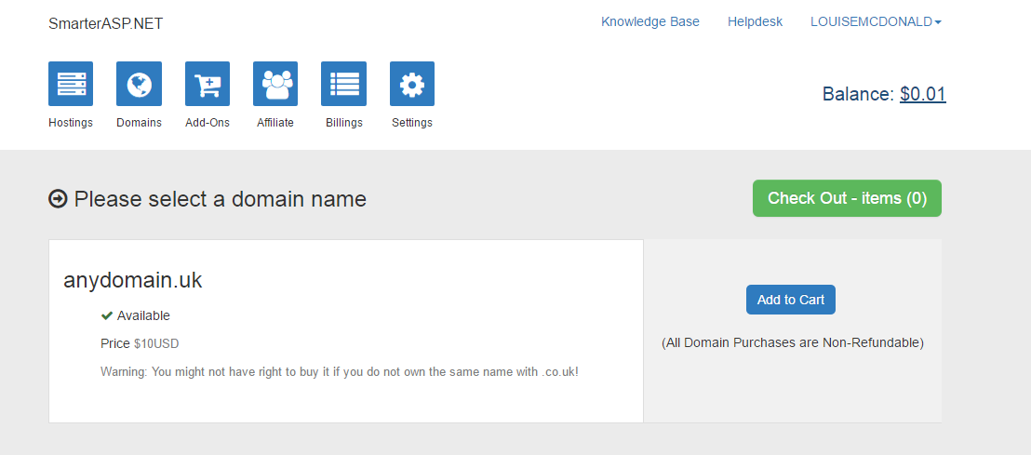
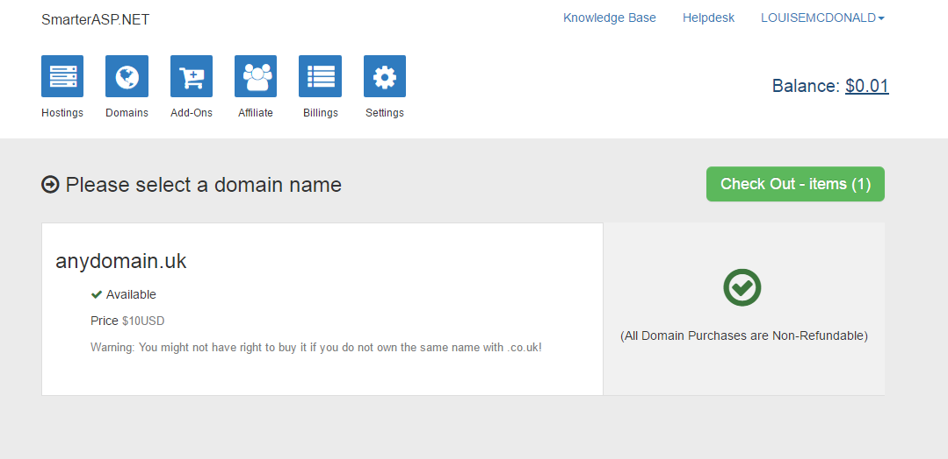
Buying a domain (5)

Slide 26
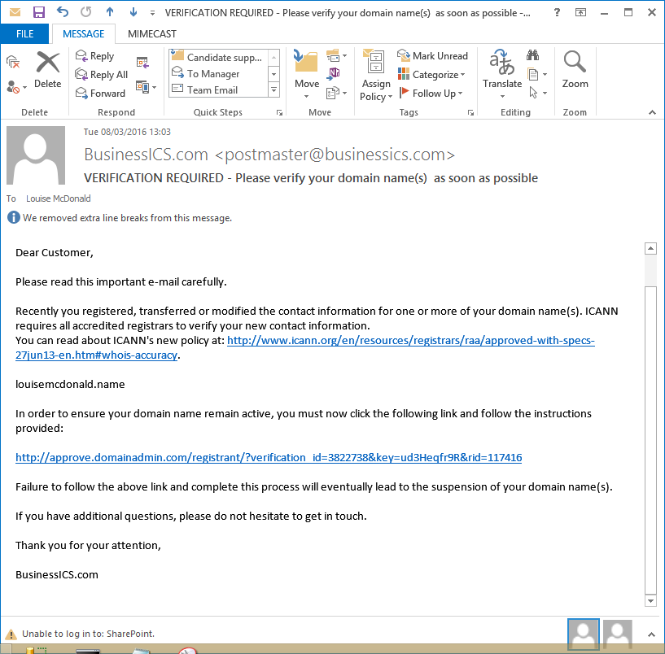
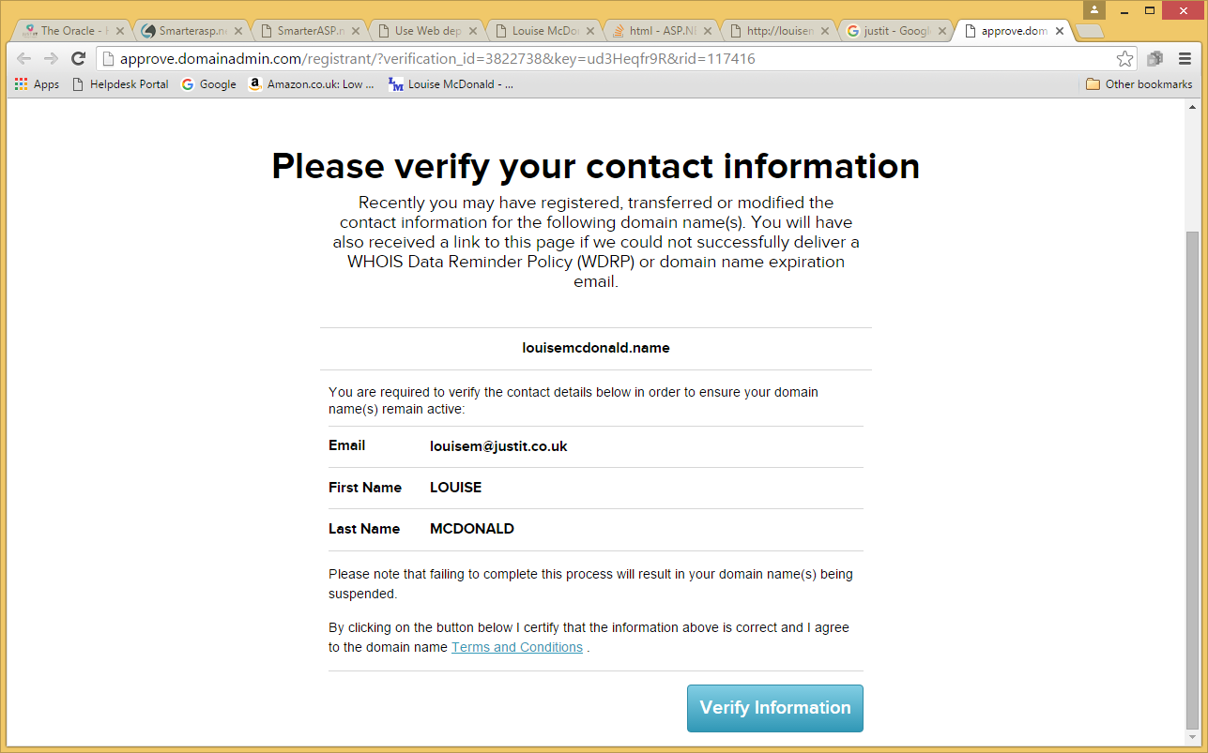
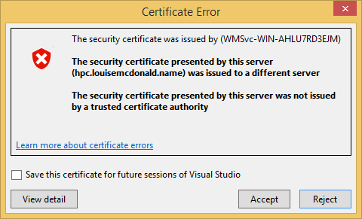
Buying a domain (6)
You will get a verification email
Follow the instructions, including accepting the security certificate error

Slide 27
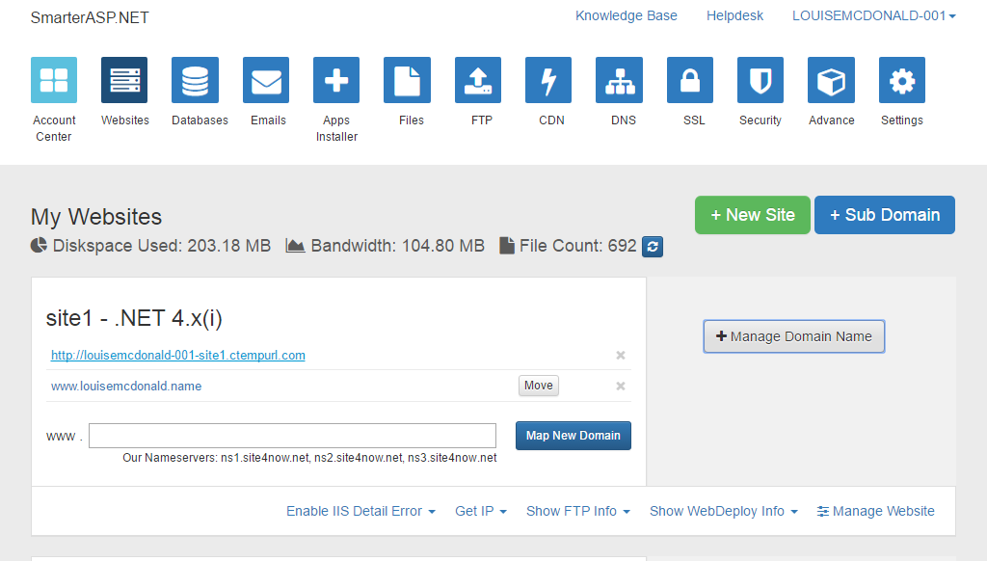
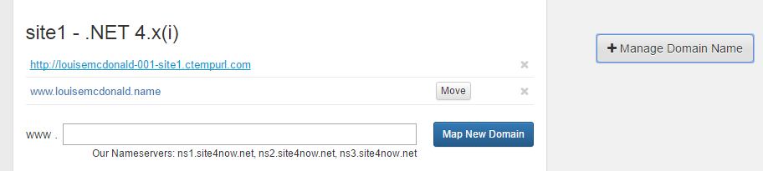
Mapping your domain
You need to map your domain to your site.
First, click Manage Domain Names
Then enter its name in this box and clicking the ‘Map New Domain’ button
Domain name now appears here

Slide 28
Subdomain

Slide 29
Setting up a subdomain
Click on the Hosting Control Panel tab
Click on the +SubDomain button to open the Subdomain Manager

Slide 30
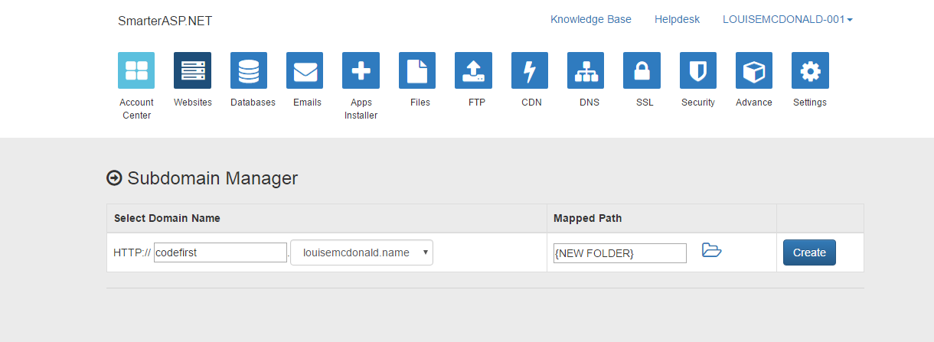
Setting up a subdomain
Enter a name for your subdomain
The subdomain name will appear before the site name in your URL
Choose (New Folder)
Click Create
On the free trial, you may only be able to have one subdomain

Slide 31
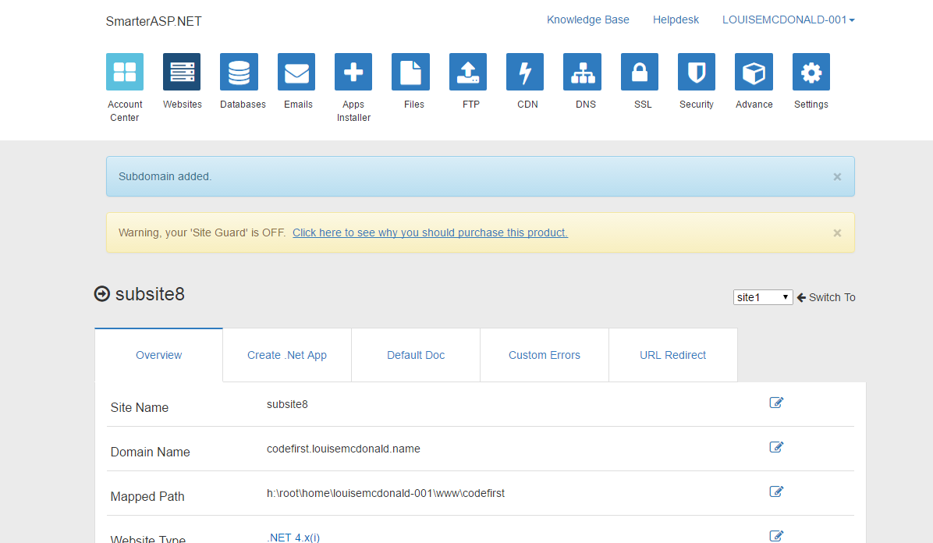
Setting up a subdomain
You should see ‘Subdomain
added’ and a new subsite
will appear, with
your subdomain name
Then click on the Websites
button to return to your list
of websites

Slide 32
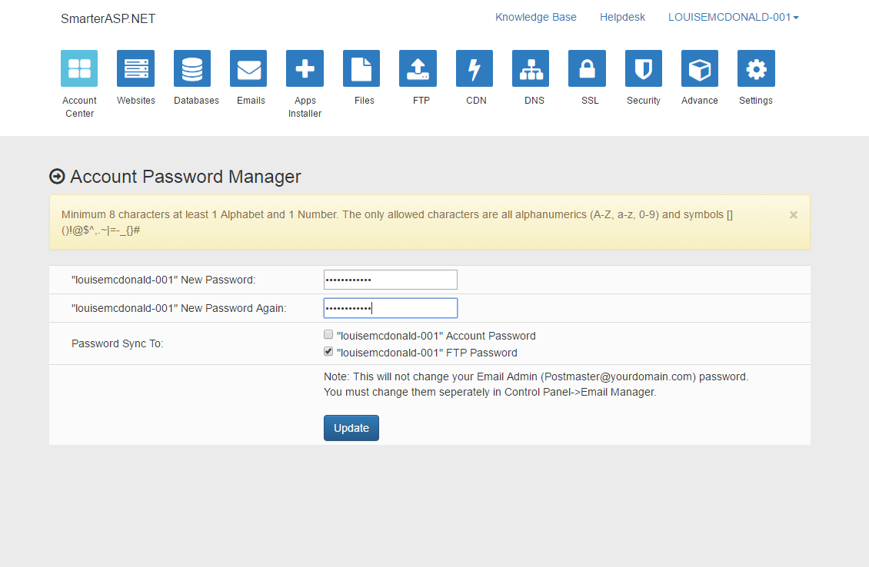
Configure Web Deploy
Change your WebDeploy password
This will only be for web deployment, unless you choose to make other passwords match
Click update
After clicking update, click the Websites button at the top to get back to where you were

Slide 33
WebForms deployment (no DB)
Change your WebDeploy password
This will only be for web deployment, unless you choose to make other passwords match
Click update
After clicking update, click the Websites button at the top to get back to where you were

Slide 34
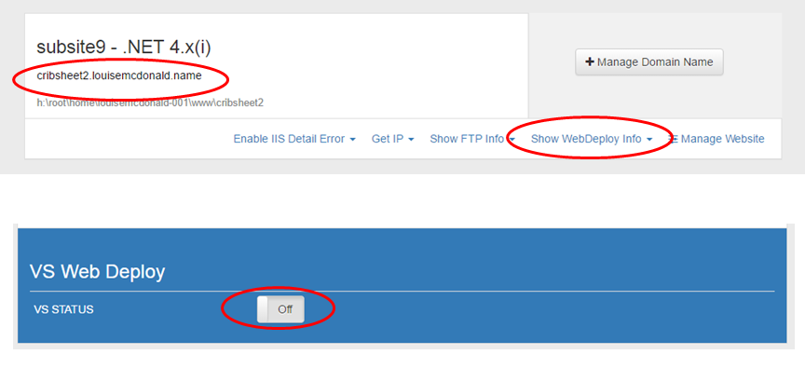
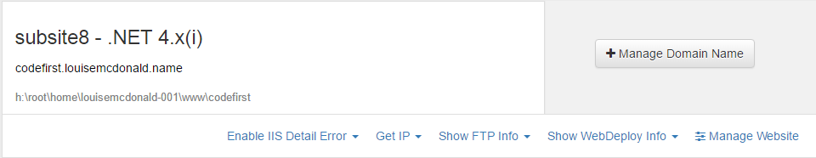
Turn on Web Deploy
If you have an ASP.NET MVC project with a database, you will deploy it using SmarterASP.NET’s WebDeploy service (after deploying the database, as described in the previous section)
Select the site that you want to deploy to and click ‘Show Web Deploy Info’
If Web Deploy is switched off, click the button to switch it on

Slide 35
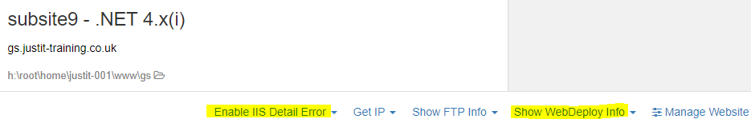
Turn on Detail Error

Slide 36
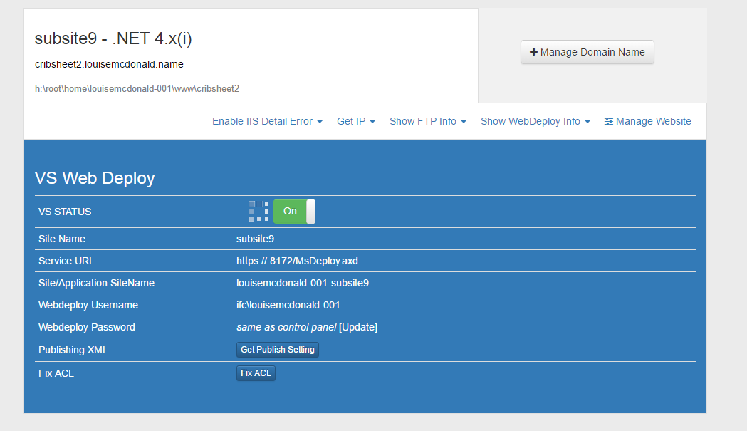
Fix ACL
Click on Fix ACL
Then click on ‘Update’ to change your WebDeploy password
(Note that the Service URL isn’t right at first – when you change your password, it will correct itself)

Slide 37
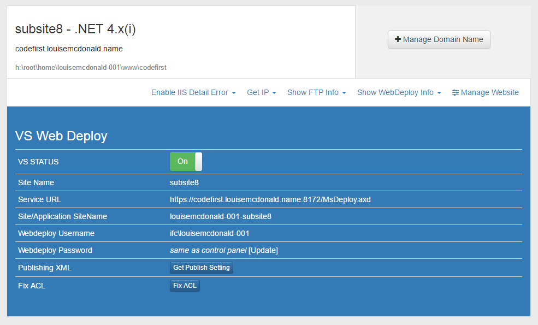
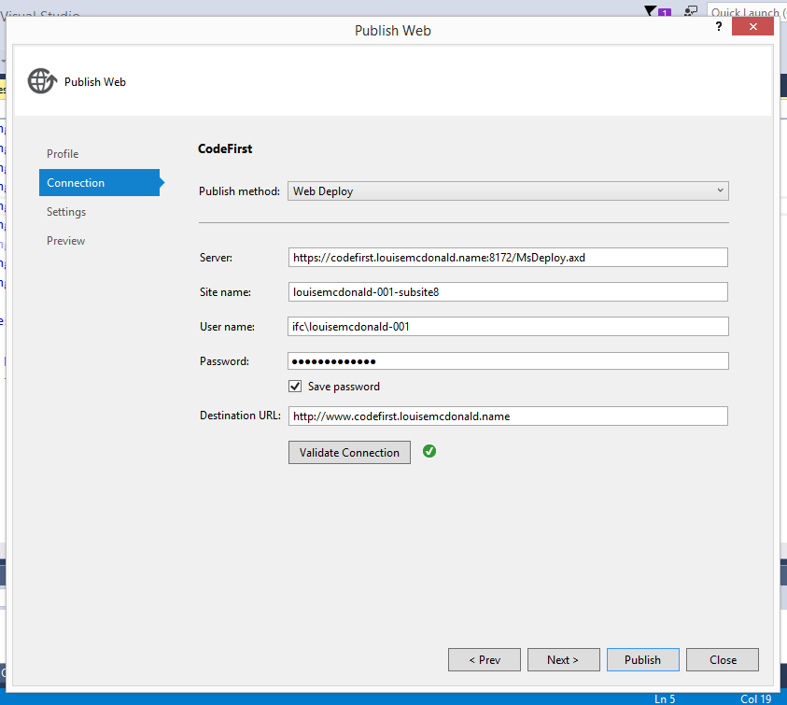
Subdomain settings for Visual Studio
Use the information from SmarterASP.NET VS Web Deploy to fill in the publish profile in Visual Studio
This will be the Web Deploy password(the one you just changed)
This is the URL at which your web app will appear

Slide 38
File Permission

Slide 39
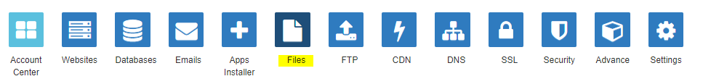
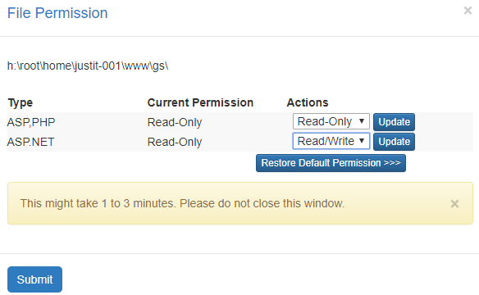
Set Files to Read Write Permission
Click on Files
Select file path
Set permission

Slide 40
Database

Slide 41
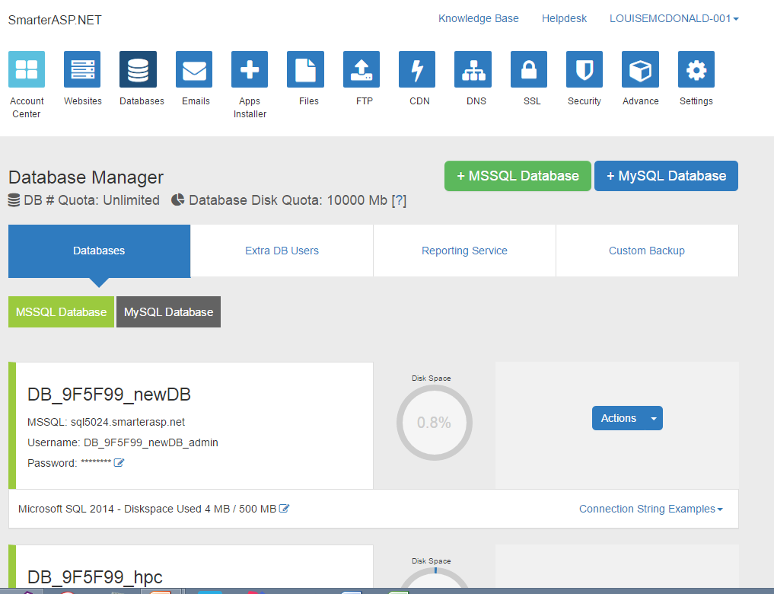
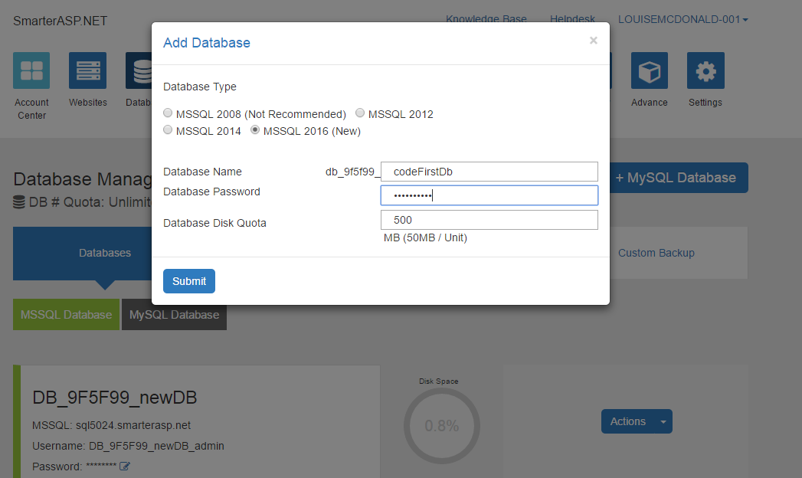
Create a database on your site
Select the Databases button then click +MSSQL Database and fill in the details in the Add Database dialog (keep the password short, as long passwords are sometimes truncated)

Slide 42
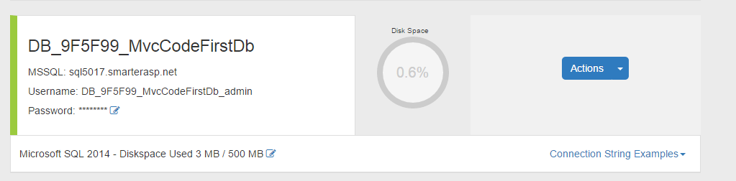
Attach the .mdf
Your new database area should be visible in the list of database areas
Then click on the Actions button and select the ‘Attach MDF file to database option’

Slide 43
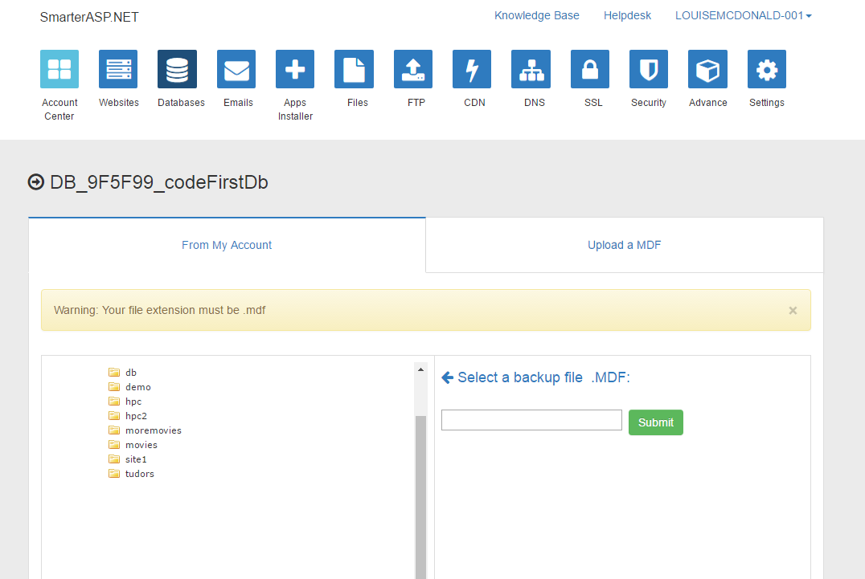
Upload the .mdf
Click on the ‘Upload an .MDF’ tab

Slide 44

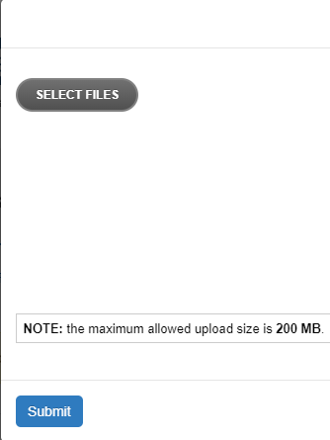
Enable Flash
Click on secure padlock
Site Settings
Enable Flash

Slide 45
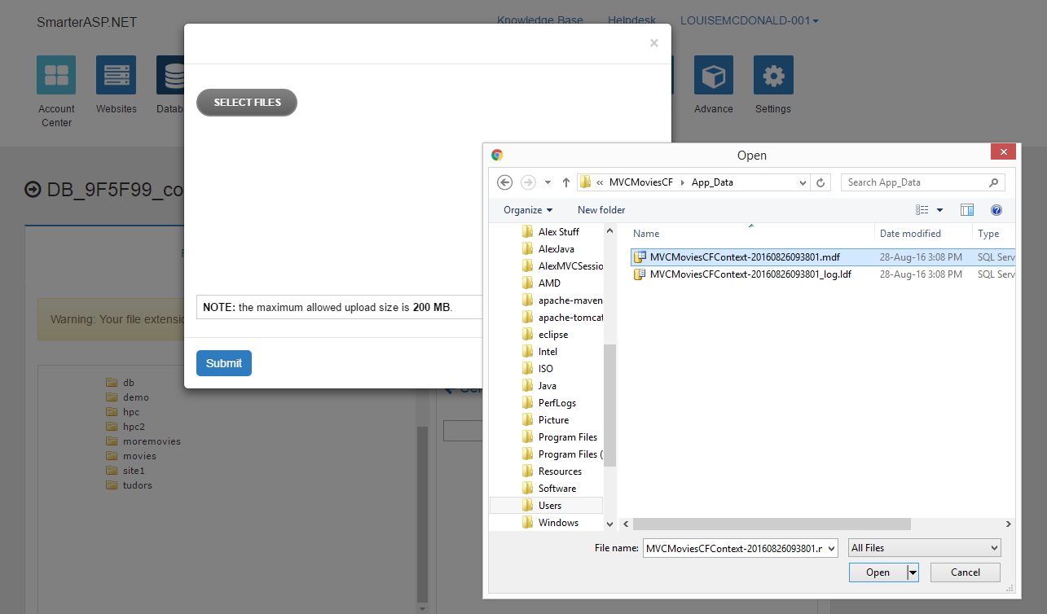
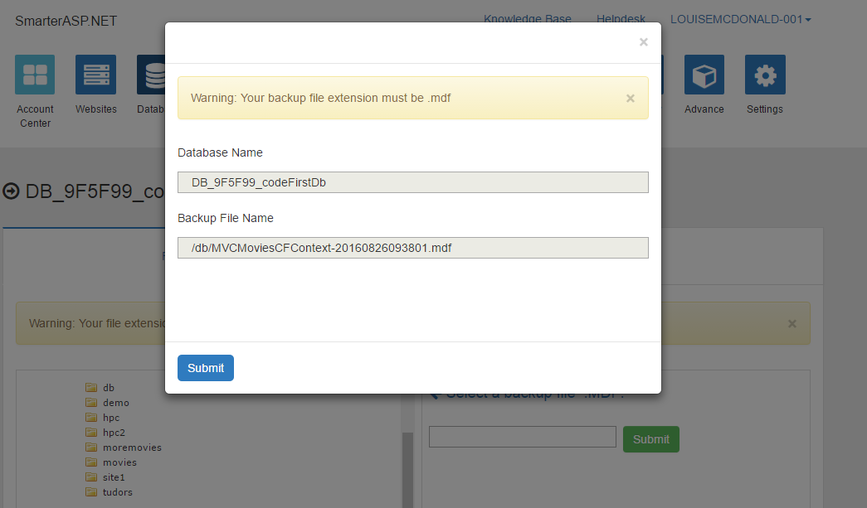
Uploading the database onto your site
Where to find your database file:
For Database First projects, it is often in your project’s App_Data folder
For Code First projects, if it’s not in the App_Data folder, it’s probably in C:\Users\yourUserName
Click on the ‘Upload an .MDF’ tab
Browse to your database file – this will be a .mdf file
Click Open
Click Submit
Your database file is now deployed

Slide 46
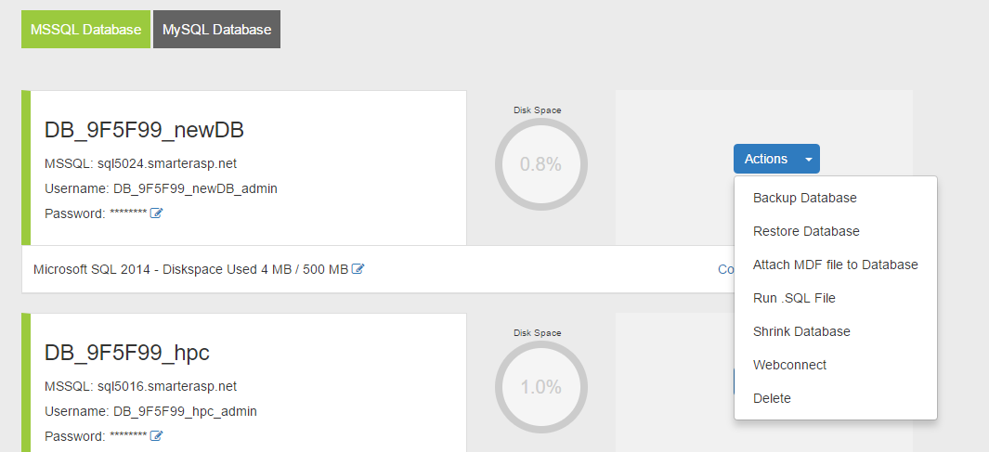
Database deployment from a .BAK file
You can also deploy a database from its backup (.BAK) file if you prefer.
Just choose ‘Restore Database’ from the menu and upload the file similarly to the previous slide

Slide 47
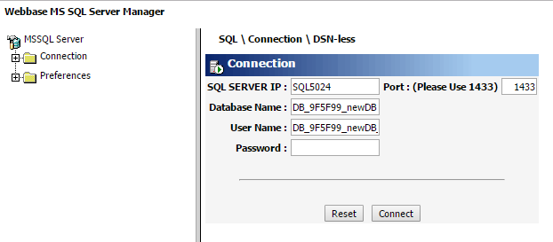
Web Connect : Check database deployed
Check that your database deployment has worked correctly
Select the ‘WebConnect’ option from the database menu
Login using the password that you used to set up the database location on the SmarterASP.NET site

Slide 48
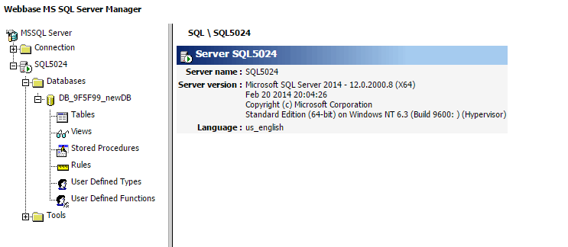
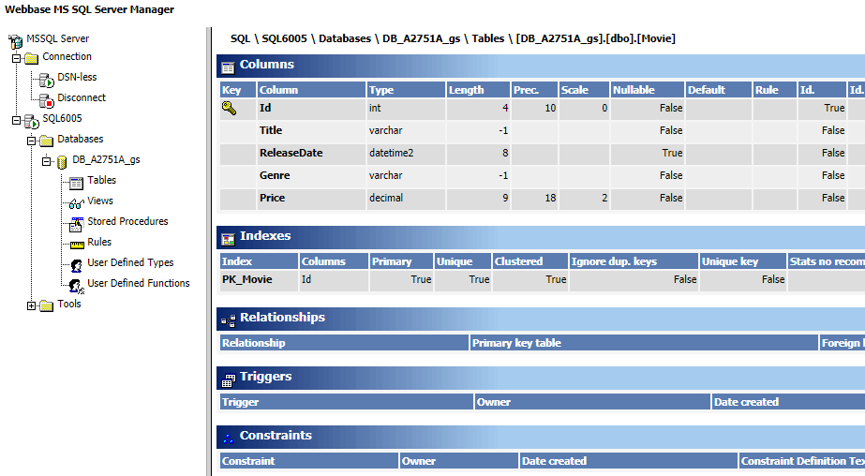
Check Tables for structure
You will then see this screen – click on Tables to see a list of tables
Click on the table name to check the table design

Slide 49
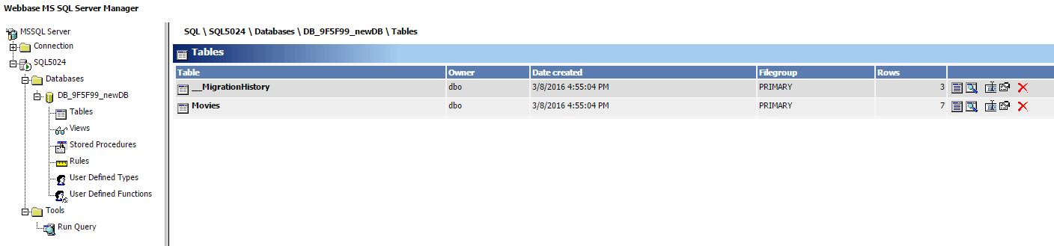
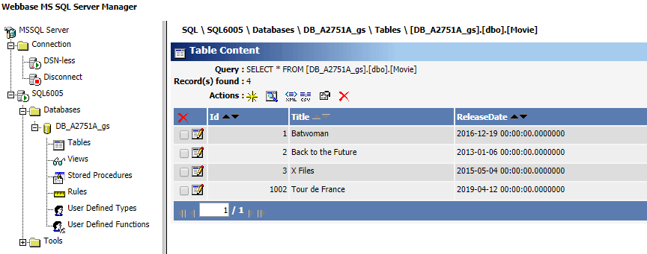
Check Tables for data
You will then see this screen – click on Tables to see a list of tables
Then click on the first icon in the group on the right to see your data

Slide 50
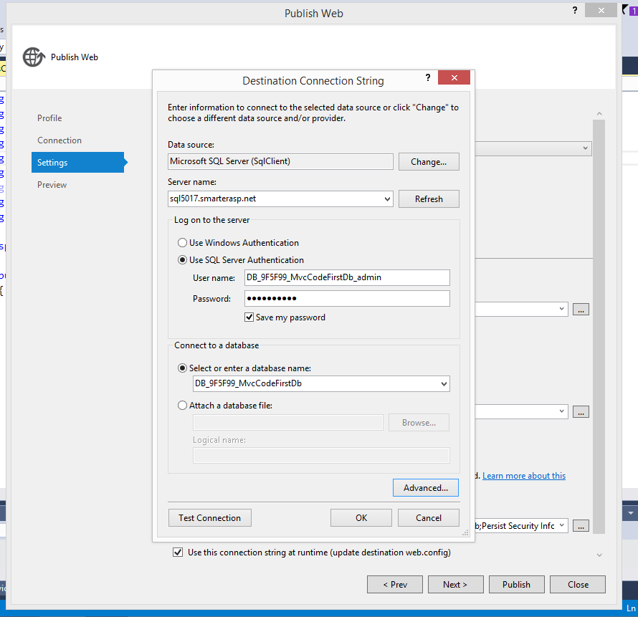
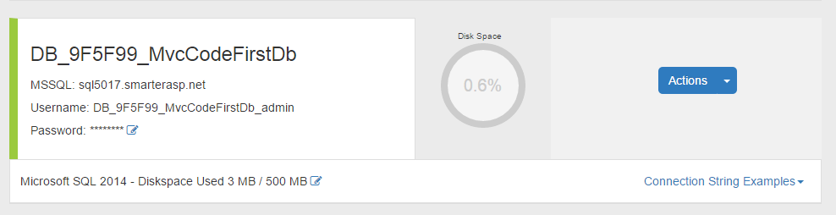
Database settings for Visual Studio
DB name
Server Name
User name
Password

Slide 51
Publish in Visual Studio
Code base and Database

Slide 52

Open the MVC project
Open Visual Studio
Open your MVC project

Slide 53

Create a Profile
From menu click Build > Publish
Select ‘Custom Profile’
Give the profile a name

Slide 54

Manage Profiles
Build > Publish
Select Manage Profiles
Here you can delete existing profiles

Slide 55
Set Subdomain connection
Use the information from SmarterASP.NET VS Web Deploy to fill in the publish profile in Visual Studio
This will be the Web Deploy password(the one you just changed)
This is the URL at which your web app will appear

Slide 56

Set Database connection
On the next dialog, leave the first and third checkboxes unchecked
Select the correct context name for the database that you want to link to your code
Click the … button next to it
Ensure you select the correct context (This is the database instance)
The MoviesAprilEntities is the Data Model used in this example

Slide 57
Enter Connection Details
Database name: DB_A2751A_gs
Server name: MSSQL: sql6005.site4now.net
Username: DB_A2751A_gs_admin
Password: ********

Slide 58

Set Advanced Properties
Make sure that Persist Security Info and Trust Server Certificate are set to true
Click OK, which will return you to the Destination Connection String dialog
Then click Test Connection
If you get a dialog saying the connection succeeded, then click OK twice to return to the Publish Web dialog

Slide 59

Test Connection Details

Slide 60

Confirm Connection String Set
The Database Connection string should now be set
Click Next
The database connection string tells your code how to connect to your database (it will be stored in the web.config file)
Check the box that says ‘Use this connection string at runtime’

Slide 61

Web.config
The Web.config file stores the connection information for the database connection

Slide 62
Publish in Visual Studio
No Database

Slide 63


Slide 64

WebForms deployment (no DB)
Open Visual Studio
Open your WebForms website

Slide 65

WebForms deployment (no DB)
From the Build menu, select Publish Web App
Select ‘Custom Profile’
Give the profile a name

Slide 66


Use the information from SmarterASP.NET VS Web Deploy to fill in the publish profile in Visual Studio
This will be the Web Deploy password
(the one you just changed)
This is the URL at which your web app will appear
When you’ve finished, click
Validate Connection
If you get a green tick, click Next

Slide 67

WebForms deployment (no DB)
Accept the security certificate

Slide 68

WebForms deployment (no DB)
On the next dialog, it’s okay to check all the boxes
Then click Publish

Slide 69

WebForms deployment (no DB)
You will see information in the Output window to show that Visual Studio is publishing the project
When the publishing process has finished, if it has been successful, your deployed web app will be opened in a browser

Slide 70
Common Errors

Slide 71

Common issues
This is probably a problem with your userid or password: https://en.wikipedia.org/wiki/List_of_HTTP_status_codes#4xx_Client_errors Possible causes include: leading or trailing spaces in your userid - this can happen very easily if you are copying and pasting from the SmarterASP.NET site wrong password - you will end up with several different passwords on the SmarterASP.NET site. The one you need here is the WebDeploy password - you will have changed it when setting up WebDeploy on your subdomain. long password - I think SmarterASP.NET sometimes truncate passwords (though they deny it). Passwords of about 10 characters seem to be safe. I have had trouble with passwords of about 16 characters. If you have any doubts about your WebDeploy password, you can just change it and try deployment again. You could send me a screenshot of what you have typed into the Publish dialog and I'll see if I can spot anything amiss. I suggest that you come in tomorrow (this is a classroom week), so that we can sort it out. If it isn't any of the above, then it might take a day or two to resolve, so it's best to starting tackling it asap.

Slide 72

Permissions error
You may see this error page when you first deploy
Follow the instructions in the next few slides to fix it

Slide 73

Fixing the permissions error
Follow the instructions in the error message by copying the <customErrors mode =“Off”/> tag into your Web.Config file (the one at the bottom of the Solution Explorer in Visual Studio) inside the <system.web> tags.

Slide 74

Fixing the permissions error
Republish the project – just select Publish from the Build menu and click the Publish button in the wizard (you won’t need to enter any deployment information again) and you should see a more informative error screen

Slide 75

Access denied
Note that the error message ends in .exe and mentions roslyn. Roslyn is the name of the compiler and the message means that the compiler is unable to write executable files (which is essential for it to compile code successfully).
You now need to go into SmarterASP.NET and check that the permissions on the file path above are all set to Read/Write.

Slide 76


Fixing the permissions error
Go back to your Smarter ASP.NET control panel and click on the Files icon
You will see a list of folders matching all your subdomains
Find the subdomain that you just deployed to and click the File Permission button next to it

Slide 77


Fixing the permissions error
You will see a dialogue with file permissions on it – if the permissions are Read-Only, then this is the source of the problem. If you don’t see Read-Only here, you may have to go lower in the file tree to find it
On the line that says ASP.NET, change the permissions to Read-Write, click the update button and wait until the update has finished
Then return to your web application, press F5 to refresh, and the application should display correctly

Slide 78

SQL Server connection

Slide 79
Make sure the correct Database Entity Context is selected

Slide 80
1. Make sure SQL Server Service is running 2. If a named instance, make sure SQL Server browser service is running 3. Make sure SQL Server is configured to allow remote connections 4. Examine the SQL Server error log for messages confirming that SQL is listening on the expected network interfaces and ports
5. Test server connectivity with PING from the client machine 6. Test port connectivity using TELNET or PowerShell to the server and port (from step 4) from the client machine. For example a. TELNET <server-name> 1433 b. PowerShell: 1433 | % { echo ((new-object Net.Sockets.TcpClient).Connect("YourServerName",$_)) "server listening on TCP port $_" } 7. Check firewall settings if step 5 or 6 connectivity test fails
SQL Server are up are runing
check the correct instance name
add in exception in firewall
check if anti virus is using it
check the sql browser services
Finally, I figured that my SQL Server Browser service in services.msc was disabled. I enabled and restarted the service. Voila, it worked!!

Slide 81
Checklist
Ensure SQL server is started and you see the following message in the SQL Server ErrorLog: SQL Server is now ready for client connections. This is an informational message; no user action is required.
Verify basic connectivity over IP address and check for any abnormalities: ping –a <SQL Server machine>, ping –a <SQL Server IP address>. If you notice any issues, work with your network administrator to fix the same.
Check if SQL is listening on appropriate protocols by reviewing the ErrorLog.
Check if you are able to connect to SQL server using a UDL file – if it works, then there may be an issue with the connection string. For instructions on the procedure about UDL test,select the option "Connect to SQL server using a UDL file " at the bottom.
Check if you are able to connect to SQL Server from other client systems and different user logins– if you are able to, then the issue could be specific to the client or login that is experiencing the issue. Check the Windows event logs on problematic client for additional pointers. Also check if network drivers are up to date.
If you are experiencing login failures, ensure the user has a login at the server level and appropriate permissions to connect to the database that the user is trying to connect to.

